Slide 1

Translating Unstructured Texts into Structured Data: A Sate of the Art
Awanish Ranjan
Rabindra Bista
DoSCE, Kathmandu University, Nepal
Notes:
1

Slide 2
Topics Covered
Introduction
Application Areas
Classification of tools
Comparative study of NLP systems
Future Direction
References
Company Logo

Slide 3
Introduction
Study of different tools for converting the unstructured text to the structured information
NLP (Natural Language Processing) techniques
Clinical domain
Extracting meaningful information like diagnosis, procedures & drug from the clinically rich texts
Difficulty
Use of abbreviations like dr., pt., dx, rx. etc.
Ambiguity
Not always following correct grammar rules
Company Logo

Slide 4
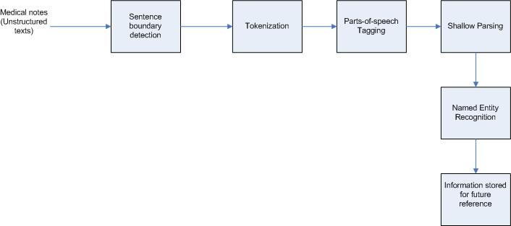
Block diagram
Company Logo

Slide 5
Application Areas
Extracting information from family history
Extracting information from notes taken by physician and nurses during appointment session
Extracting information from prescription by physician – Medication information
Extracting information from discharge summary
Document Classification – Classifying different medical documents
Company Logo

Slide 6
Tools - MedEx
Designed by Xu. H. et.al
Extracts following medication information from discharge summary
Drug name
Drug Strength
Route
Frequency
Three step process
Preprocessing – detecting sentence boundary
Semantic Tagging - each clinical sentence is broken down in tokens and each token is labeled with a semantic category like Drug name, drug strength etc.
Parsing - context-free grammar to parse the textual sentences into structured form using a chart parser
Company Logo

Slide 7
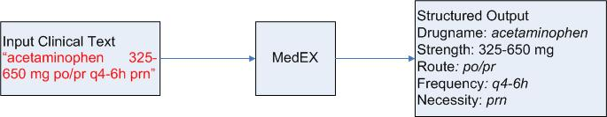
MedEX block diagram
Company Logo

Slide 8
Tools - cTAKES
clinical Text Analysis and Knowledge Extraction System (cTAKES)
Developed by Shovava K.G. et.al
Information extraction from EMR data
Based on following open source technologies
Unstructured Information Management Architecture (UIMA) framework
OpenNLP
Data used – subset of clinical notes from Mayo Clinic EMR
Company Logo

Slide 9
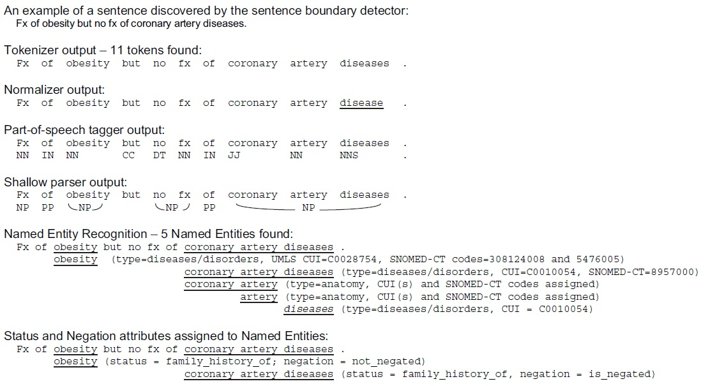
cTAKES sample output
Company Logo

Slide 10
Tool - YTEX
Developed by Glara V. et.al
Based on cTAKES
Used for classification of radiology reports to suggest that the case is of hepatic decompensation
Modifies cTAKES by using
A regular expression based named entity recognition
Latest version of NegEx algorithm to detect Negation
A database module to store the annotations in the database
Company Logo

Slide 11
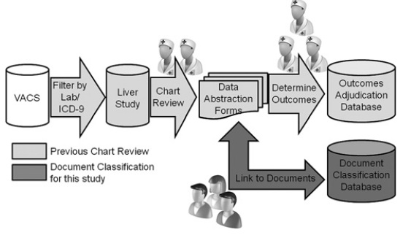
YTEX block diagram
Company Logo

Slide 12
Comparative study
Type of Data (ToD)
Application Domain (AD)
Preprocessing (PRE)
True Positive (TP), True Negative (TN), False Positive (FP), False Negative (FN)
Precision (P) - P = TP / (TP + FP)
Recall (R) - R = TP / (TP + FN)
F-score (F) - F = (2*P*R) / (P+R)
Ambiguity Resolution (AR)
Redundancy Handling (RH)
Approach (A) – General (G) or Specific (S)
Processing Type (PT) – Centralized (C) or Distributed (D)
Company Logo

Slide 13
Comparison Result
Tools\Metrics | ToD | AD | PRE | P | R | F | A | AR | RH | PT
MedEX | Medication | Clinical (Drug) | Y | 0.97 | 0.88 | 0.92 | S | Y | N | C
cTAKES | Mayo clinical EMR | Clinical (EMR) | N | 0.80 | 0.64 | 0.71 | G | N | N | C
YTEX | Radiology document | Clinical (Radiology) | N | 0.96 | 0.92 | 0.94 | S | N | N | C
Company Logo

Slide 14
Future Direction
Distributed processing capability
Mobile Platform
Redundancy Handling
Ambiguity Resolution
Company Logo

Slide 15
References
Xu, H.; Stenner, S.P.; Doan,S.;Johnson, K.B.; Waitman,L.R.;Denny, J.C MedEx: a medication information extraction system for clinical narratives; Journal of the American Medical Informatics Association (JAMIA), 2009; pp. 19-24
Savova G.K,; Masanz,J.J.; Ogren, V.P.; Zheng, J.; Sohn, S.; Kipper-Schuler, C.K.;Chute, G.C. Mayo clinical Text Analysis and Knowledge Extraction System (cTAKES): architecture, component evaluation and applications; ; Journal of the American Medical Informatics Association (JAMIA), 2010; pp. 507-513.
Garla, V.; Re, L.V. III; Dorey-Stein, Z.; Kidwai, F.; Scotch, M.; Womack,J.; Justice,A.; Brandt,C. The Yale cTAKES extensions for document classification: architecture and application Journal of the American Medical Informatics Association (JAMIA), 2011; pp. 1-7
Liddy, E.D. Natural Language Processing; Encyclopedia of Library and Information Science 2nd Edition,2001
Company Logo

Slide 16
References
Ronan Collobert, R.; Weston, J.; Bottou, L.; Karlen, M.; Kavukcuoglu,K.; Kuksa, P. Natural Language Processing (Almost) from Scratch; Journal of Machine Learning Research 12, 2011
Wolniewicz, R. Auto-Coding and Natural Language Processing; 3M Health Information Systems
Madnani, N.; Getting Started on Natural Language Processing with Python
Wu, Y.; Denny, C.J; Rosenbloom, S.T.; Miller, R.A.; Giuse, D.A.;Dr.Ing; Xu, H. A comparative study of current clinical natural language processing systems on handling abbreviations in discharge summaries; Department of Biomedical Informatics, Department of Medicine, School of Medicine, Vanderbilt University, Nashville, TN
Bodenreider, O.; Willis, J.; Hole, W. The Unified Medical Language System; National Library of Medicine, 2004
Klassen, P. Gate Overview and Demo; University of Washington CLMA treehouse Presentation, 2010
OpenNLP, URL - https://opennlp.apache.org/ (visited on December 2014)
Company Logo

Slide 17
Thank You

